Slide 1
December 2, 2022
Pr AXEL MARCHAL
Between tradition and innovation,
the new challenges of terroir wines
Symposium d’automne
Académie Internationale du Vin
Notes:
D

Slide 2
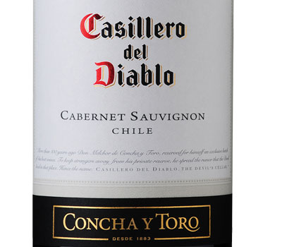
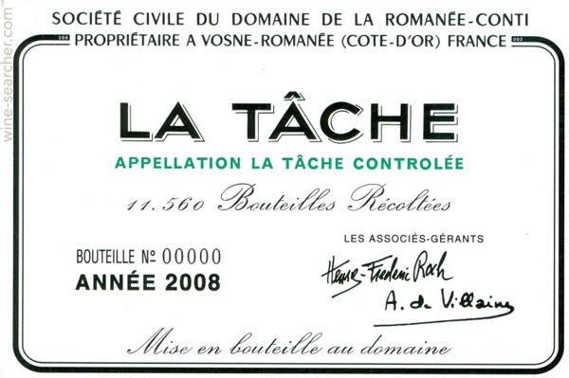
Variety vs Terroir
Notes:
Création de valeur

Slide 3
How a « terroir » can be defined ?
S
Soil: geology, microbiote, water and nitrogen status
Climate
Plant material: variety, gene pool and rootstock
Human know-how: cultural practices and winemaking
C
P
H

Slide 4
Empirical human practices to reveal the terroir
T
To produce « good » grapes, the vine must be cultivated in a way that limits both vegetative growth (vigor) and fruit production
To obtain quality grapes, it is above all necessary to control the vigor so that vine growth stops just before « véraison »
Pruning, vine density, leaf canopy, soil maintenance techniques must be adapted to environmental conditions
T
P

Slide 5
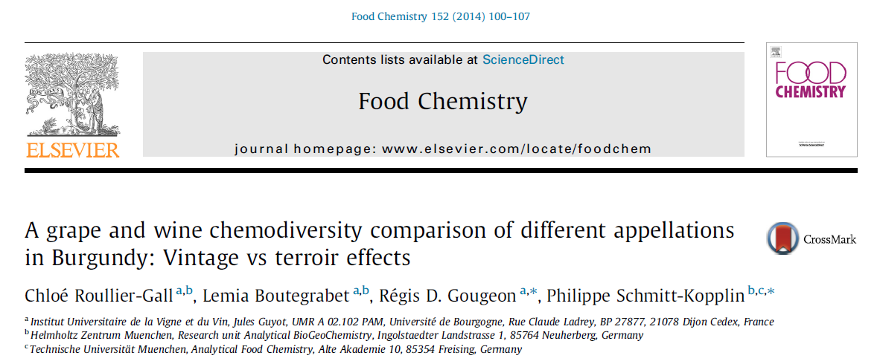
Is there any chemical fingerprint of terroir?
Notes:
Terroir : pérennité des caractéristiques

Slide 6
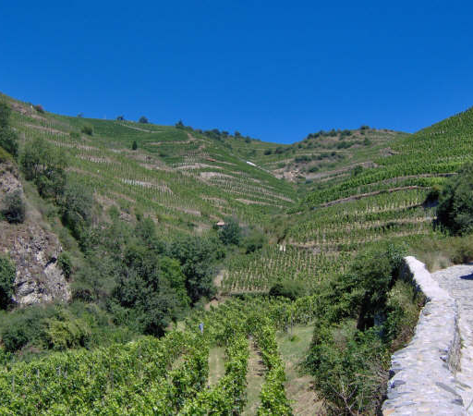
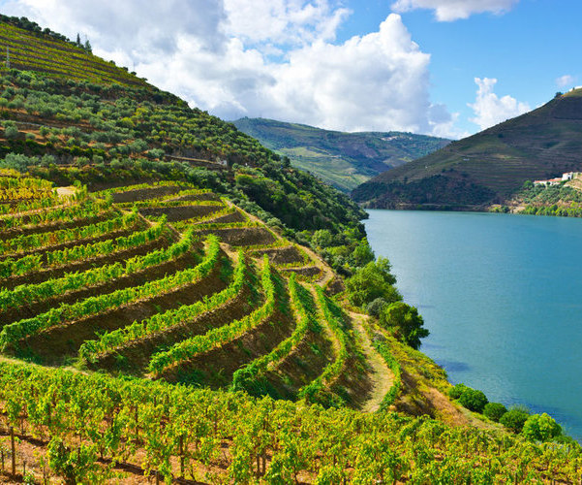
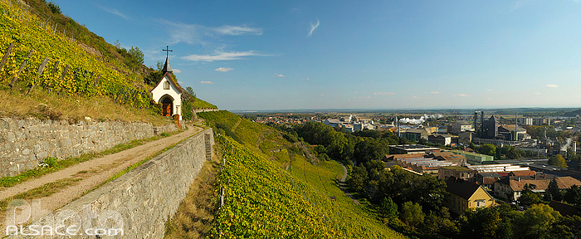
What is the true definition of the terroir?
Effet terroir : capacité avérée d'un territoire, à « produire », grâce au savoir faire humain un vin possédant un goût typique, apprécié d'un marché qui en reconnaît durablement la singularité et la valeur
Denis Dubourdieu

Slide 7
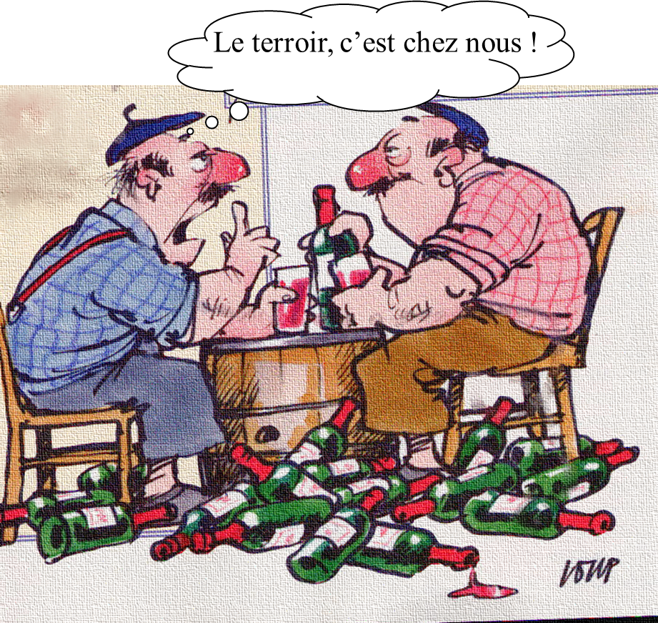
What is the true definition of the terroir?
Si la typicité du vin n'est pas démontrée, le terroir n'est au mieux que virtuel, hypothétique, au pire, un refuge d'habitude et de langage

Slide 8
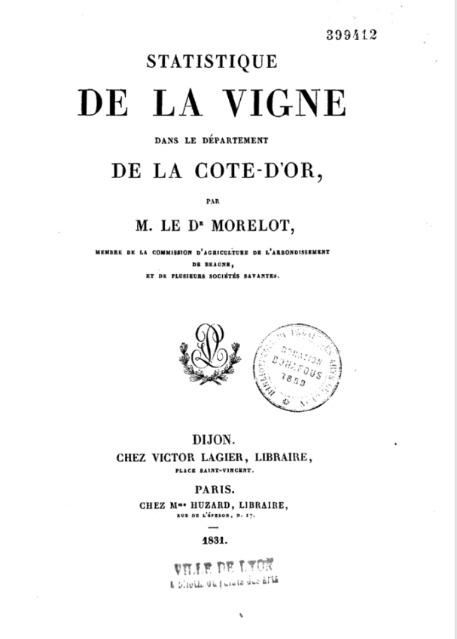
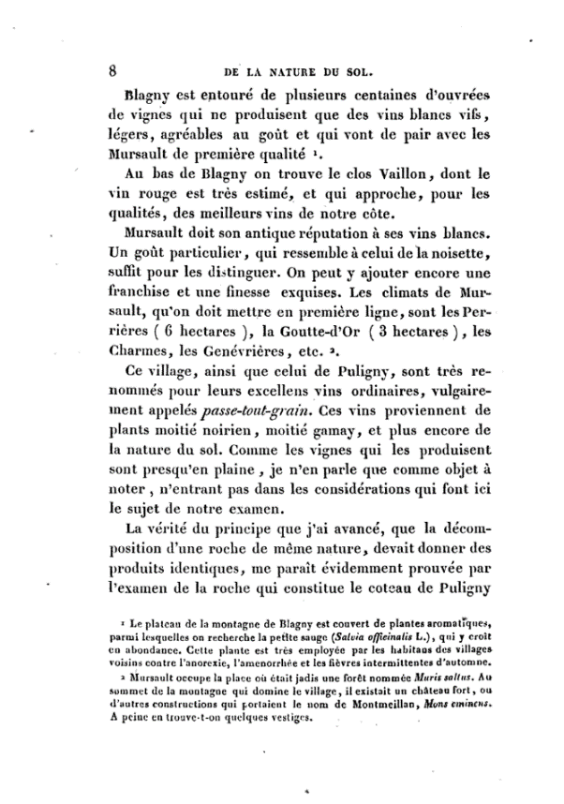
Terroir identity in the face of change
1831
« Meursault doit son antique réputation à ses vins blancs. Un goût particulier, qui ressemble à celui de la noisette, suffit pour les distinguer. »

Slide 9
Terroir identity in the face of change
www.vins-bourgogne.fr
2022
« Le Meursault blanc […] évoque la grappe mûre. En vin jeune : l’amande et la noisette grillée dans un environnement végétal et floral (aubépine, sureau, fougère, tilleul, verveine) et minéral (silex). »

Slide 10
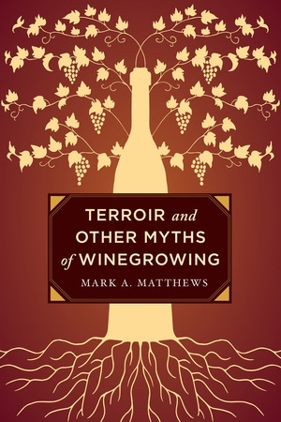
Potential threats to terroir wines?

Slide 11
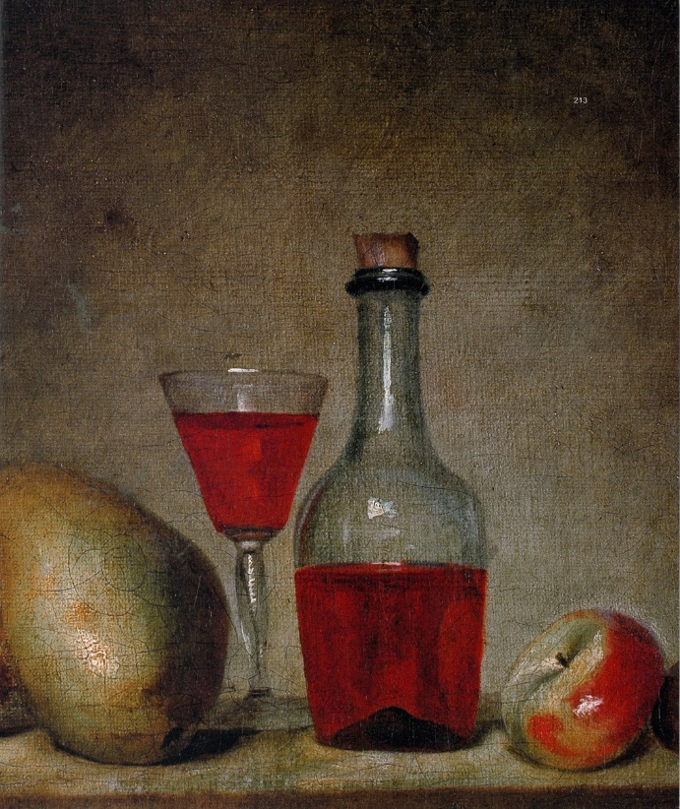
The challenge of climate change
François VISPRE (1730-1790)
« Nature morte »
J-F de TROY(1679-1752)
« Un déjeuner de chasse »

Slide 12
Evolution of the composition of Bordeaux Cabernet Sauvignon berries at two times: 1893 and 2006
1893
2006
 | Poids (g) | % | Poids (g) | % | Différence
Pulpe | 1,07 | 87,42 | 0,90 | 70,61 | - 15,26
Pellicule | 0,11 | 8,72 | 0,33 | 25,39 | 205,5
Pépins | 0,05 | 3,86 | 0,05 | 4 | 8,72
Total | 1,22 | 100 | 1,28 | 100 | 4,92
From JM Chevet

Slide 13
Evolution of sugar content in must
From JM Chevet

Slide 14
Analyses of some Bordeaux 1840 by Fauré
 | Alcool
Ch-Lafitte | 8,7
Ch-Margaux | 8,75
Ch-Latour | 9,33
Ch-Haut-Brion | 9
G. D’estournel | 9
Ch-Brannes-Mouton | 9
Ch-Léoville | 9,15
Ch-Gruaud-Larose | 9,85
Ch-Cantenac | 9,25
Ch-Giscours | 9,1
Ch-La Lagune | 9,3
Ch-Therme-Cantenac | 9,15
Ch-Tronquoy-Lalande | 9,9
Ch-Phelan | 9,25
From JM Chevet

Slide 15
Compared evolution of sugar content and carbon dioxide concentration
From JM Chevet

Slide 16
Evolution of grape yields in a Médoc estate
From JM Chevet

Slide 17
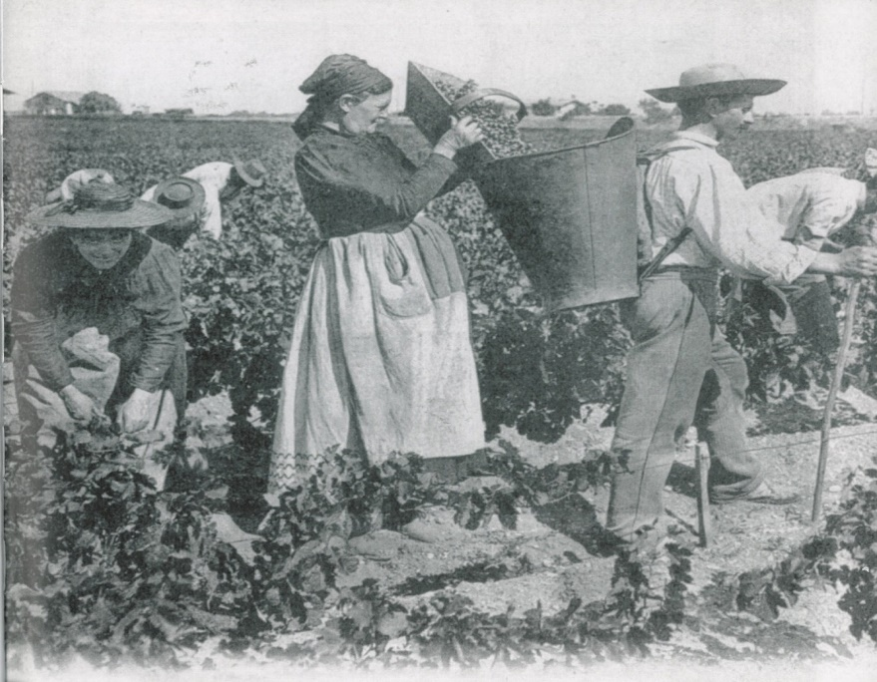
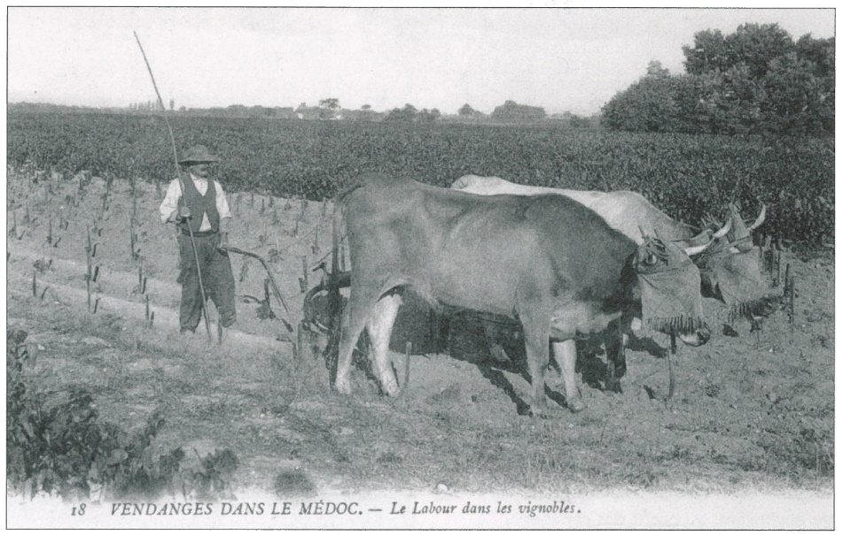
Over one century, some evolutions...
From JM Chevet

Slide 18
Consumers and global warming
Sensory evaluation (hedonic rates)
How do regular consumers react to modifications of wine charactersistics ?
Economical evaluation
(Willingness to pay WTP)
What kind of purchasing behaviour can we predict for wines from global warming ?
Tempère et al., Food Qual. Pref., 2019

Slide 19
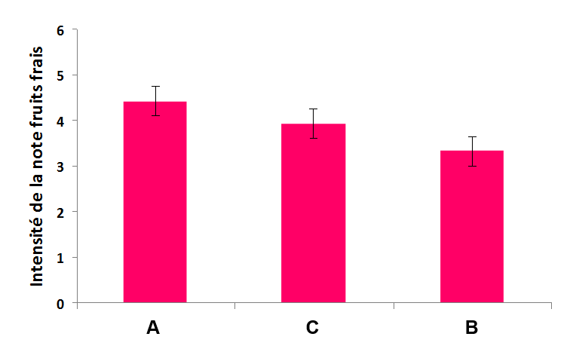
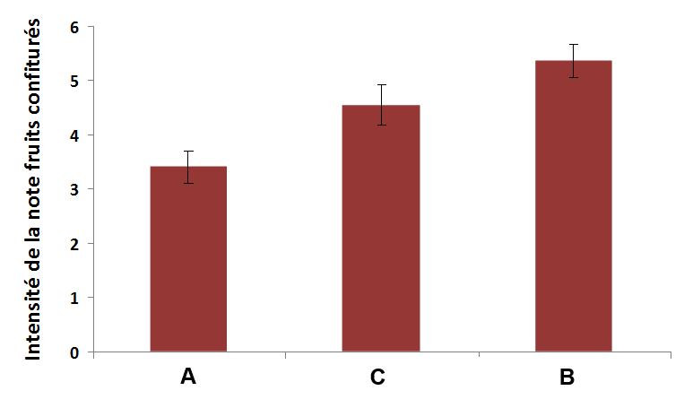
Selection of three wines from the same AOC
Wine A
Fresh fruit
Wine B
Intermediate
Wine C
Jammy, over-ripe fruits
13,9% vol
14,4% vol
15,2% vol
+
Wine A’ : °A’ =°A + 1,3%
Tempère et al., Food Qual. Pref., 2019

Slide 20
Results of the first experience
Mean WTP per wine and per step – Group 1
C
B
A
A’
Tempère et al., Food Qual. Pref., 2019

Slide 21
Results of the second experience
Mean WTP per wine and per step – Group 2
Related to G1:
+ 6,3%
A
B
- 12,8%
C
- 20%
A’
- 11,5%
Visuel
Olfactif
Gustatif
Tempère et al., Food Qual. Pref., 2019

Slide 22
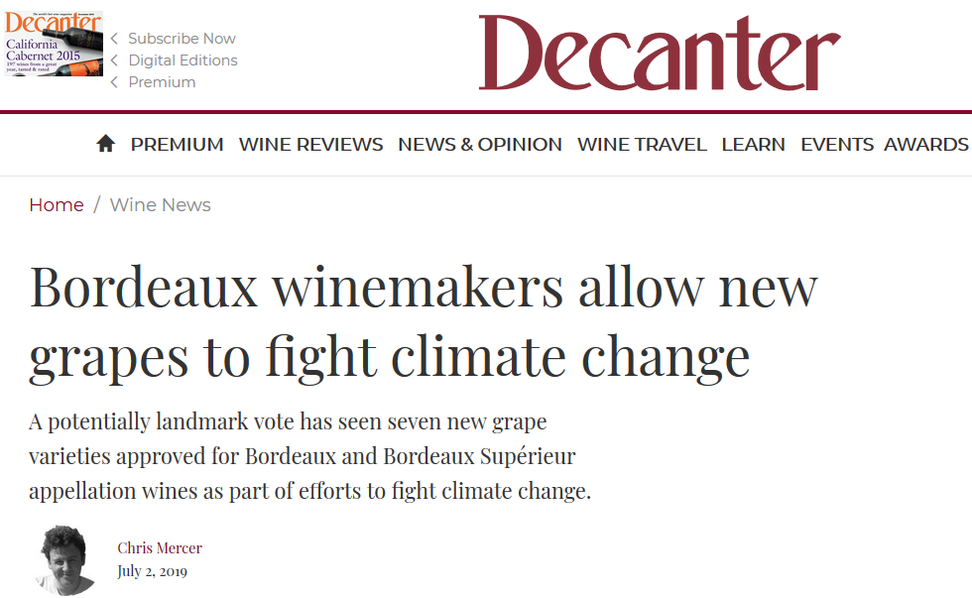
Which answers to this challenge ?
Modelization of temperature increase : replacement of classic varieties... and its consequences
Notes:
Economie expérimentale

Slide 23
Which answers to this challenge ?
High inter-individual diversity between vine-stocks: new criteria of selection
Adaptation from vinegrowers : common sense and innovation
Variety / soil
Rootstock
Leaf area
Mycorrhizes ?
A new trend: early harvests to « keep freshness »... and its limits
Notes:
Economie expérimentale

Slide 24
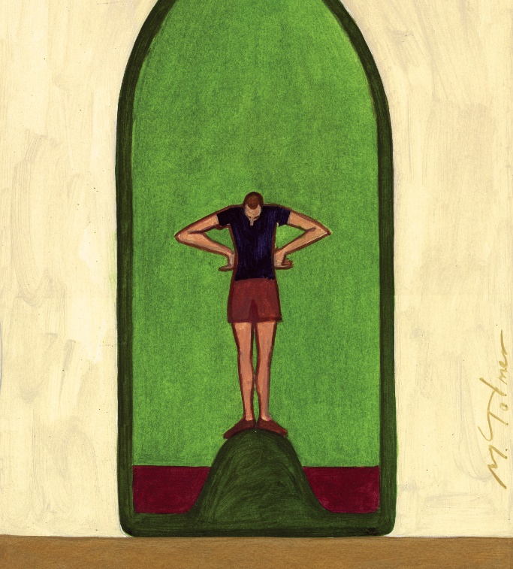
The environmental challenge
The respect for the environment has become a key-point for wine value
« Magical thinking » : we are what we eat/drink
Michel Tolmer

Slide 25
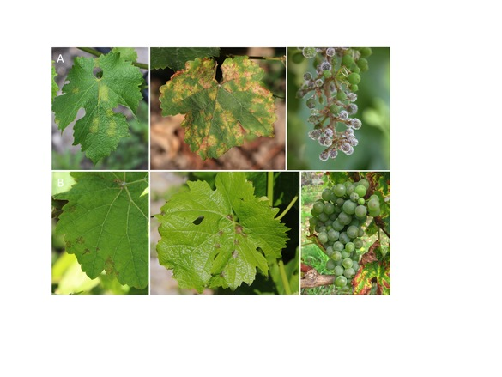
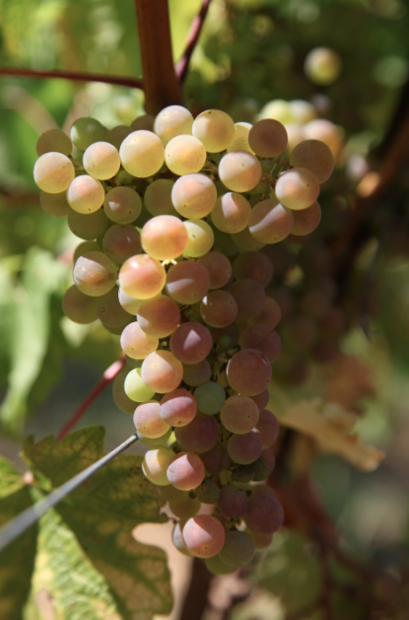
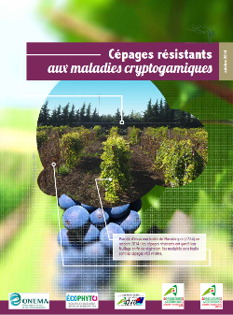
Can resistant varieties be an answer ?
Development of varieties resistant to powdery and downy mildew
1200 ha in 2022!
Significant decrease of plant-health treatments
BUT serious threat for wine identity ?

Slide 26
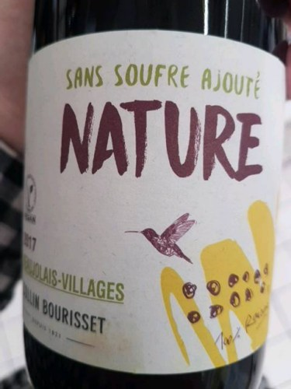
Emergence of a new category of wines
More and more attention is being paid to the elaboration process to the detriment of the origin

Slide 27
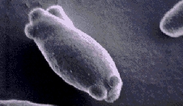
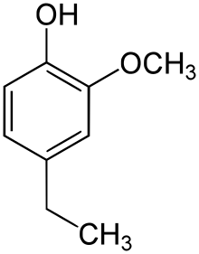
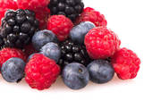
Off-flavours and spoilages: betrayal of the terroir
Brettanomyces bruxellensis
b
a
b
a
a
c
Control wine
Control wine + low level
Control wine + high level
Control wine
Control wine + low level
Control wine + high level
Tempère et al., Food Qual. Pref., 2016

Slide 28
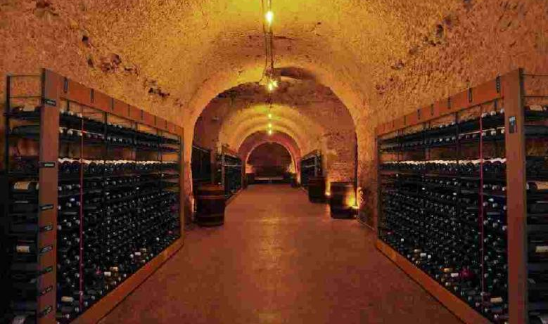
Importance of Wine Identity and Role of time
Most of great wines are drunk younger and younger
Nevertheless, great wine is not a fact but an history
The memory that we keep from a wine is essential to its identity
Ageing time is necessary to reveal the identity of the place

Slide 29
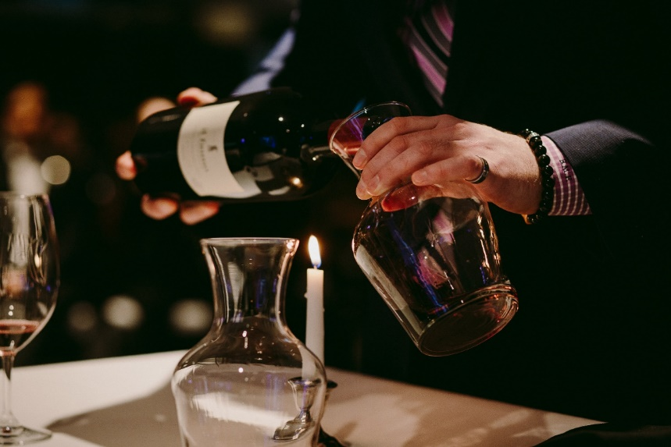
The defense of terroir wines is also a communication challenge
Wine critique: From an all-powerful voice to a broad range of influences
Importance of wine merchants, training of the sales force
Increasing influence of sommeliers
Role of social networks

Slide 30
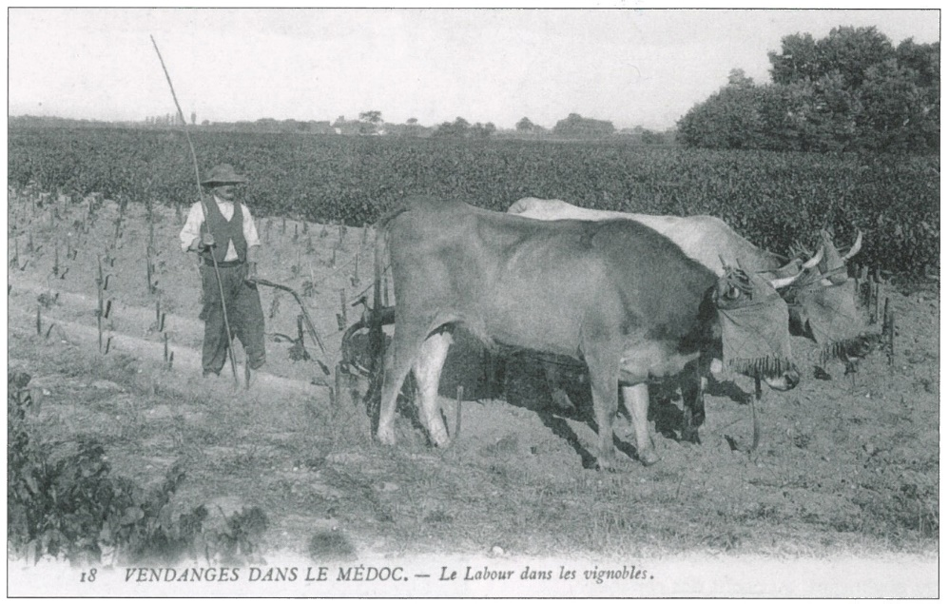
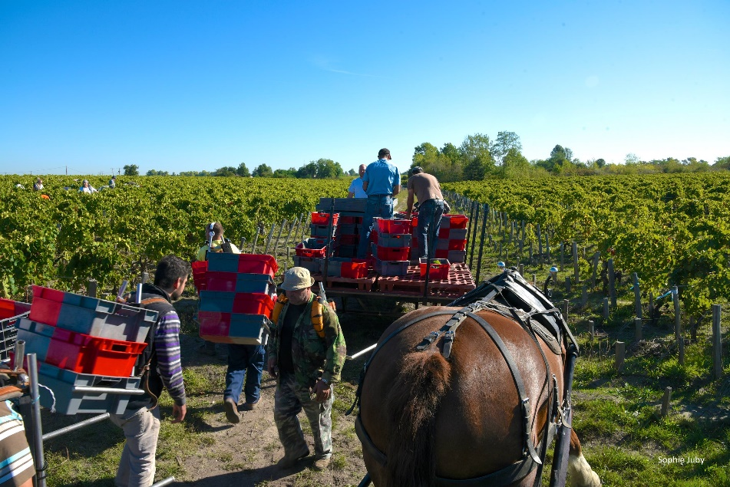
Drinking wine or drinking ideas ?
Intense thirst of « naturality »
Which message do we want to give to consumers?

Slide 31
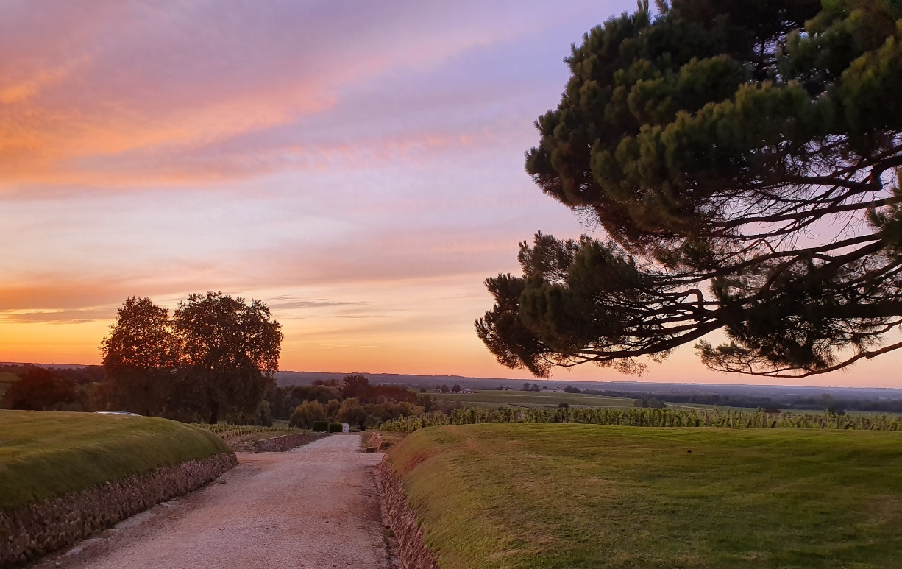
Conclusion
« La tradition n’est pas le culte des cendres mais la préservation du feu »

Slide 32
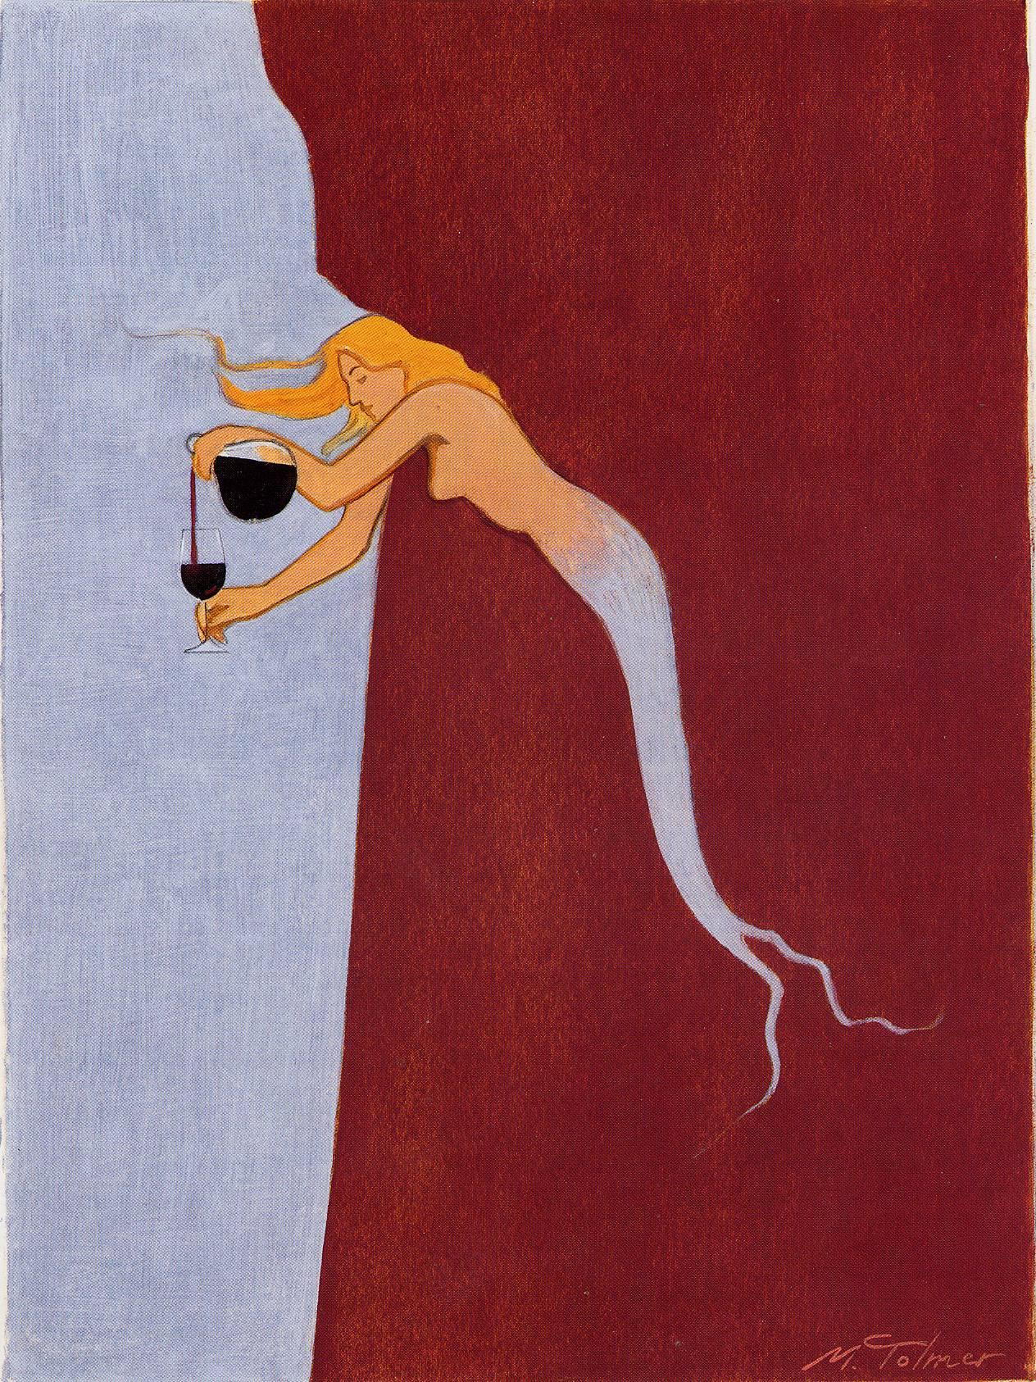
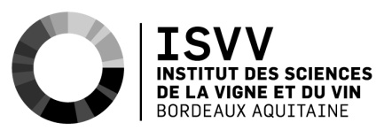
Thanks for your attention!
axel.marchal@u-bordeaux.fr

