Slide 1
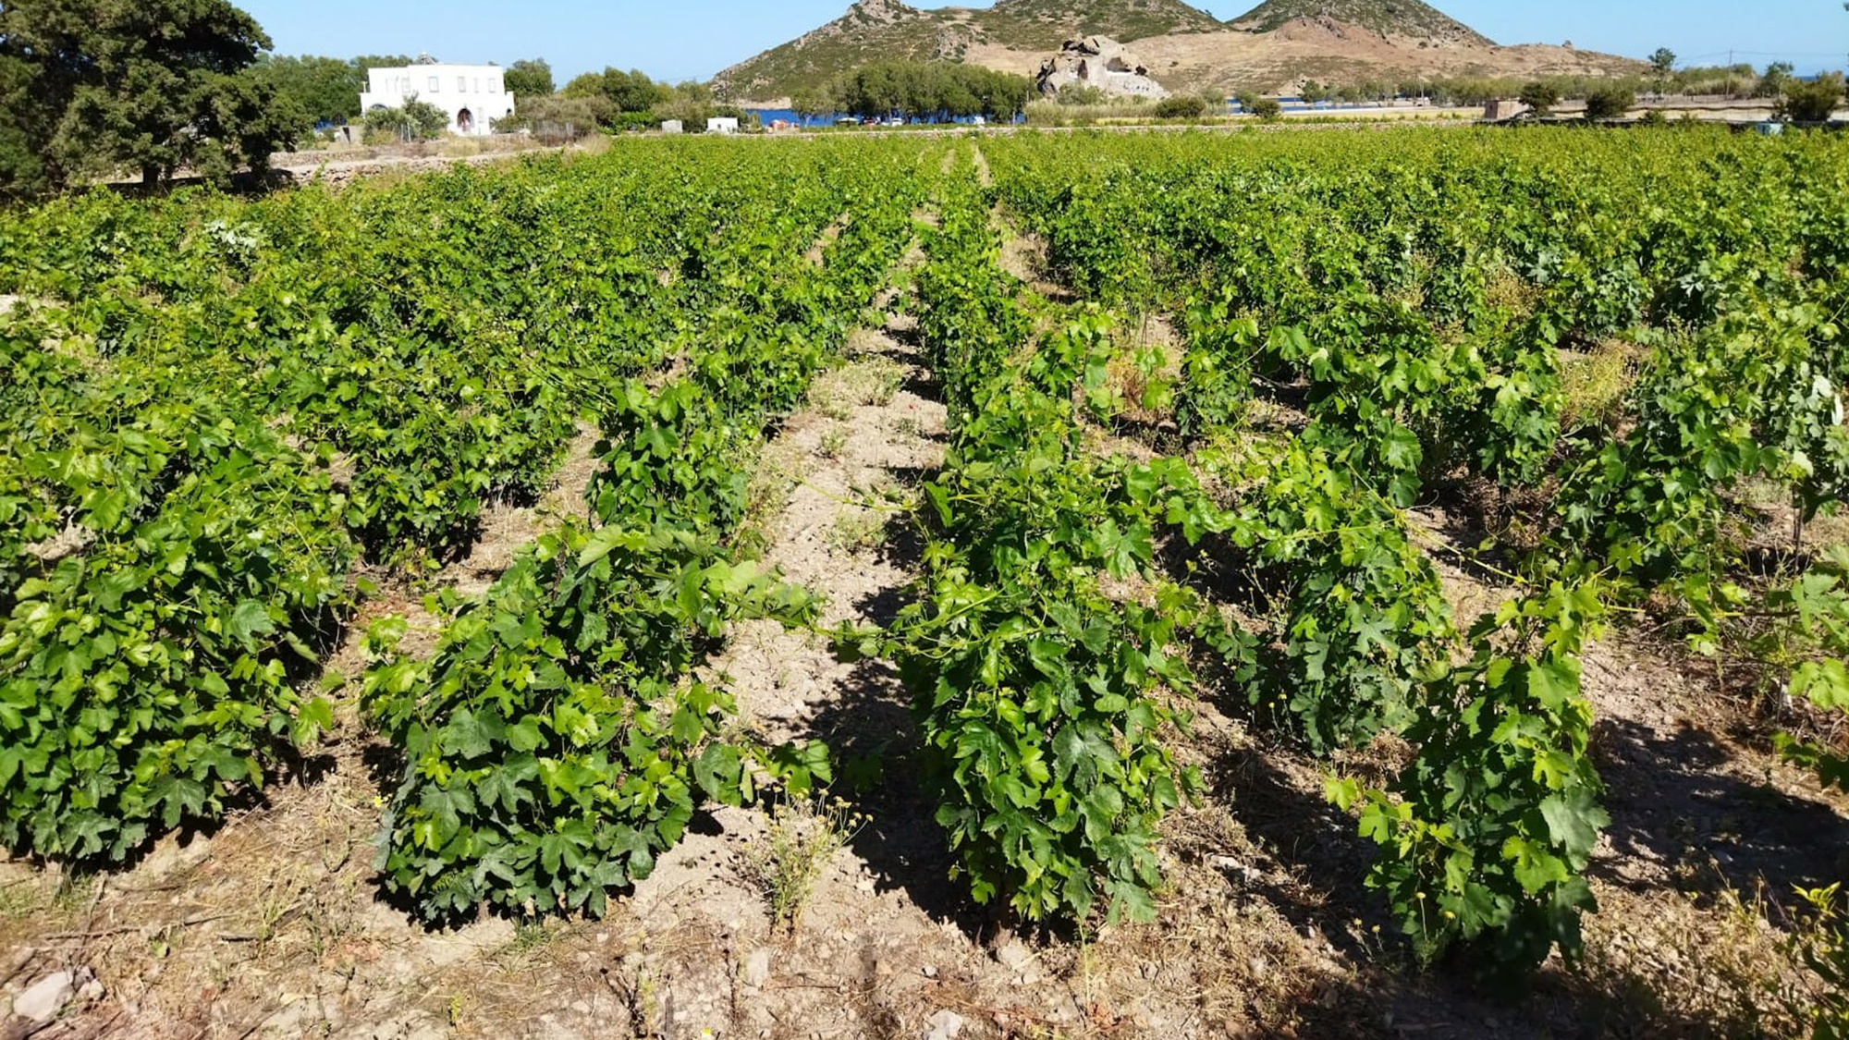
Viticulture insulaire et changement climatique dans l’ile de Patmos, Dodecanese
Federico Garzelli – Vigneron, Oenologue
Athens, 1st December

Slide 2
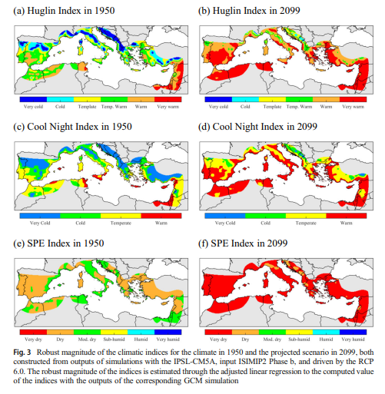
Changement climatique
+1/+3 °C global average
Satillan et al. 2019

Slide 3
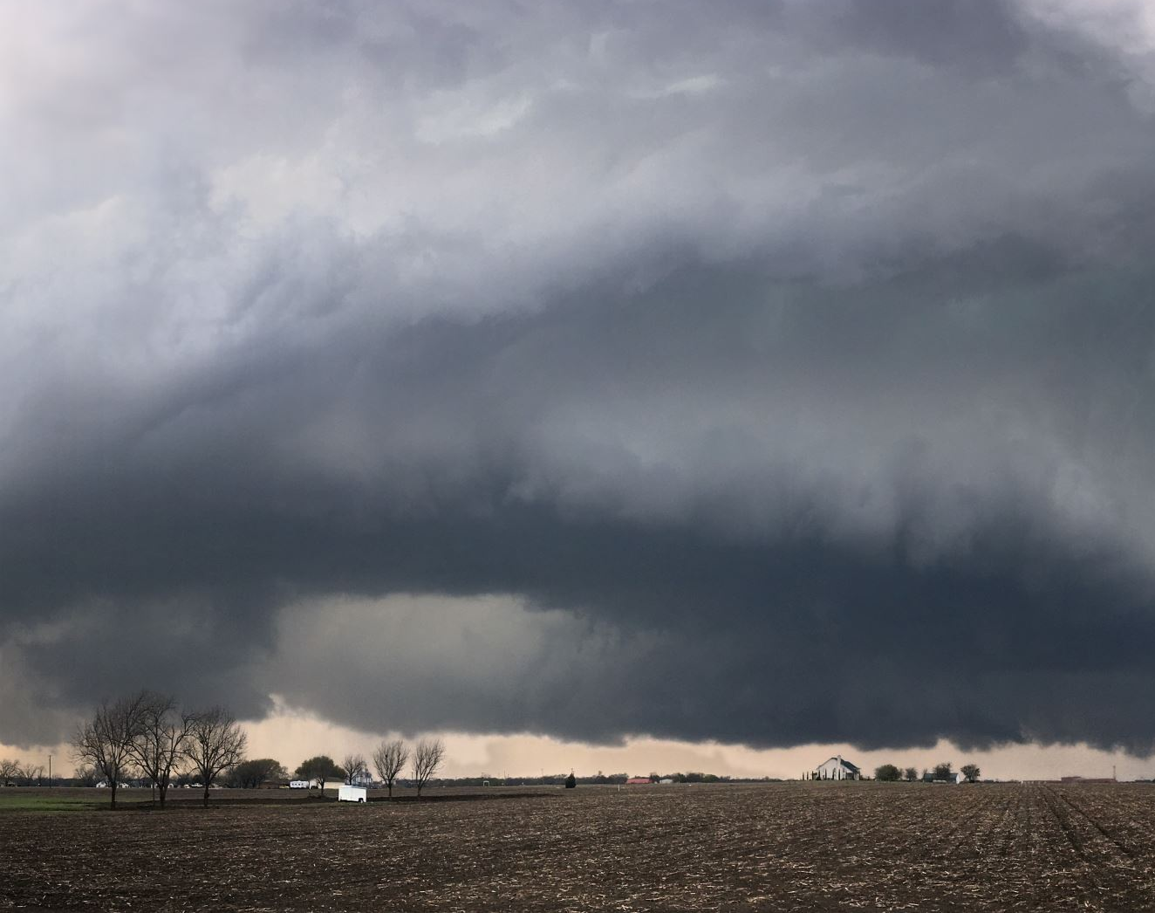
Conditions climatiques

Slide 4
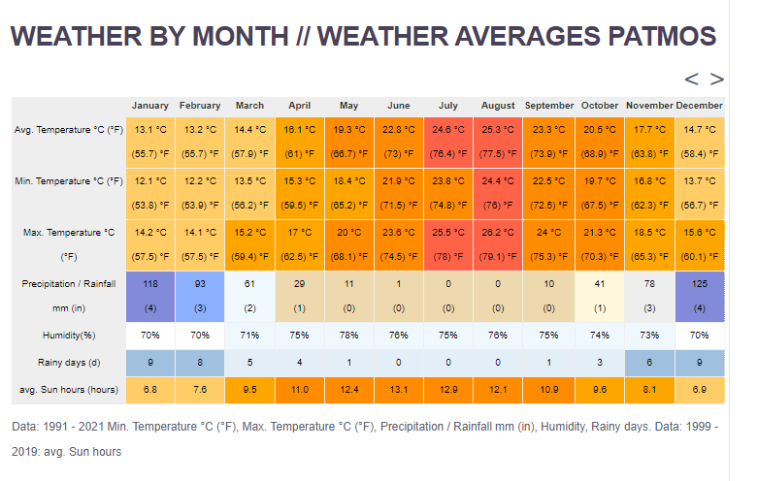
https://en.climate-data.org/

Slide 5
Quantité d’eau necessaire pour la vigne: 300-700 mm/année
https://en.climate-data.org/

Slide 6
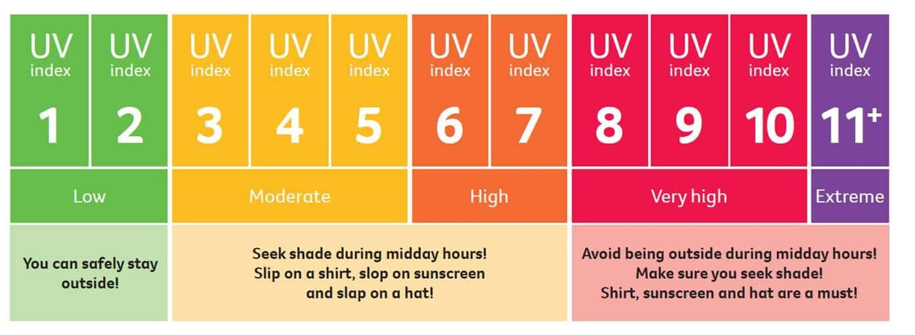
UV index en Août en Patmos

Slide 7
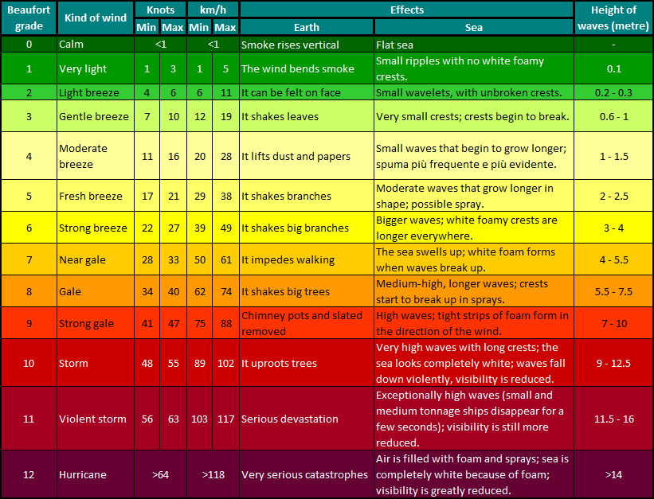

Slide 8
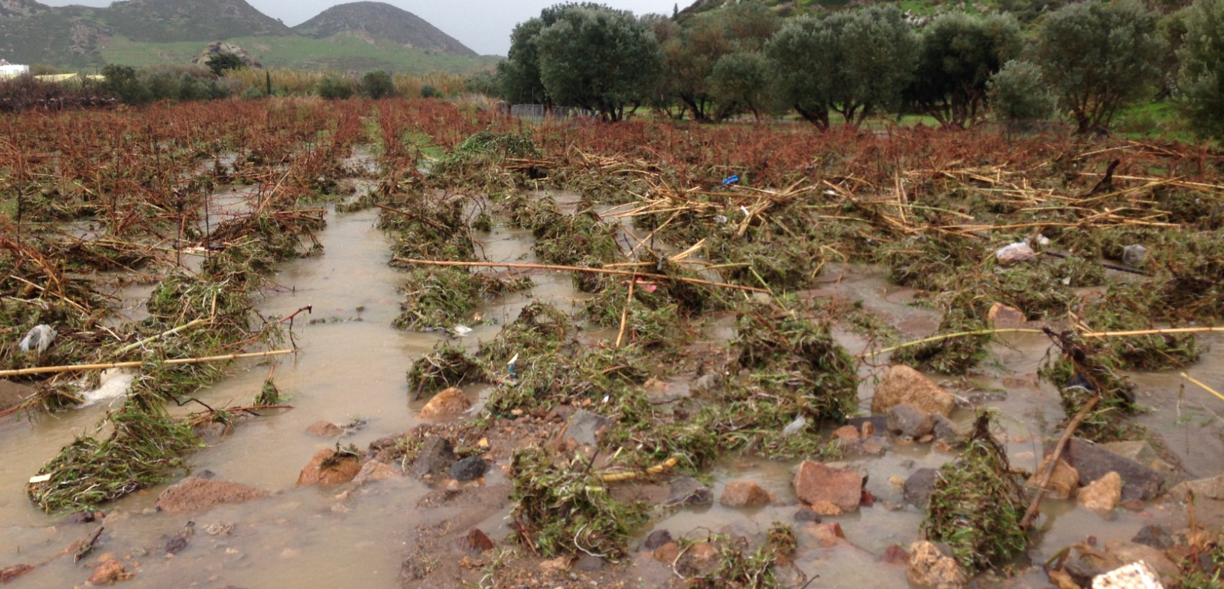
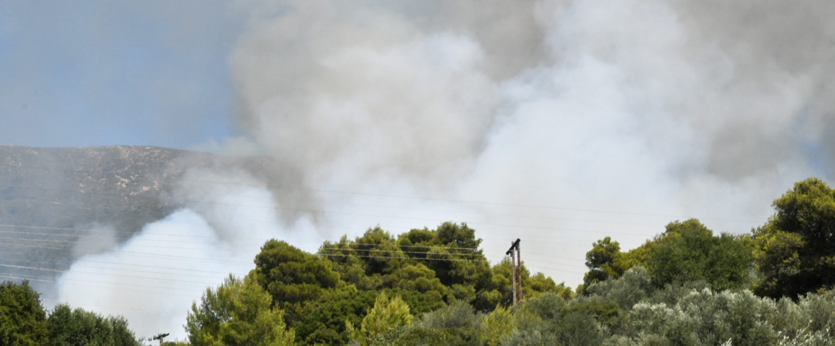
Événements climatiques extrêmes

Slide 9
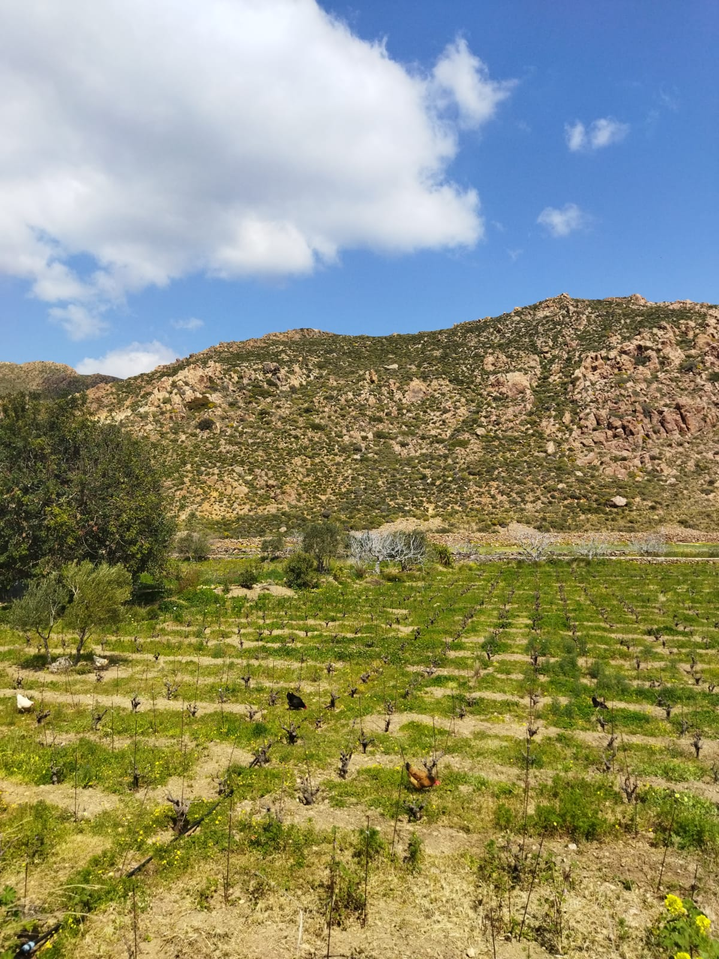
Chèvres
Sans chèvres

Slide 10
pH
AT
sucres et alcool
Maturation phénolique
arômes libres / arômes glycosylés
Sécheresse
Raisins brûlées
Pathogènes
vitalité du sol
températures du sol élevées
gas carbonique
raisins déséquilibrés

Slide 11
Double approche
Dans le vignoble
Dans la cave

Slide 12
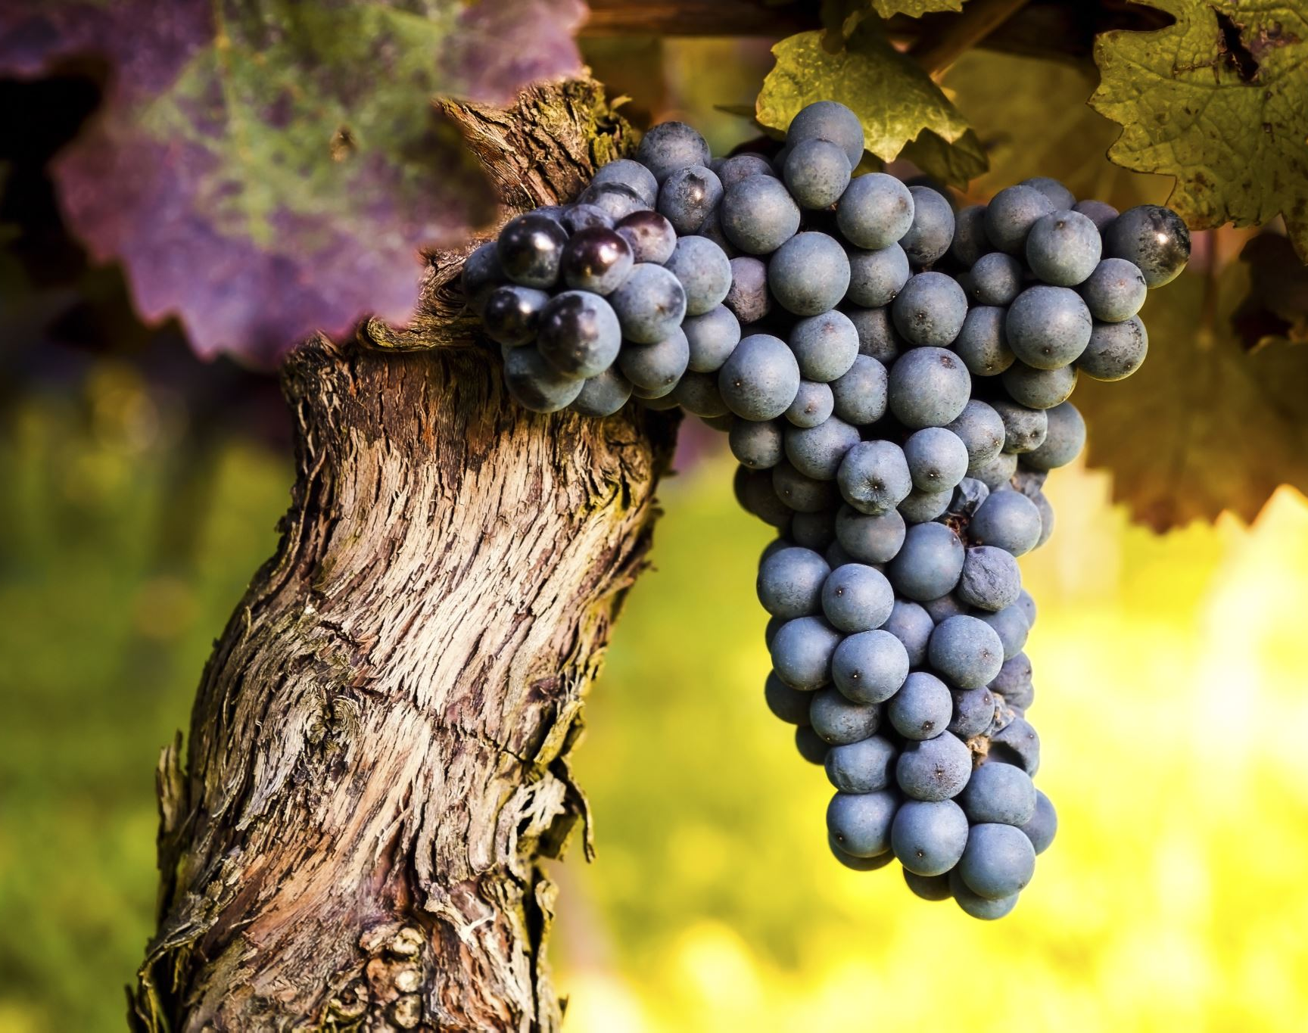
Dans le vignoble
Haute densité de plantation1,3m x 1,3: racines profondes, ombre
Goblet: consommation d’eau moderée
porte-greffe: Paulsen 1103
Franc de pied (Assirtiko)
Sans pincage: ombre sur les raisins

Slide 13
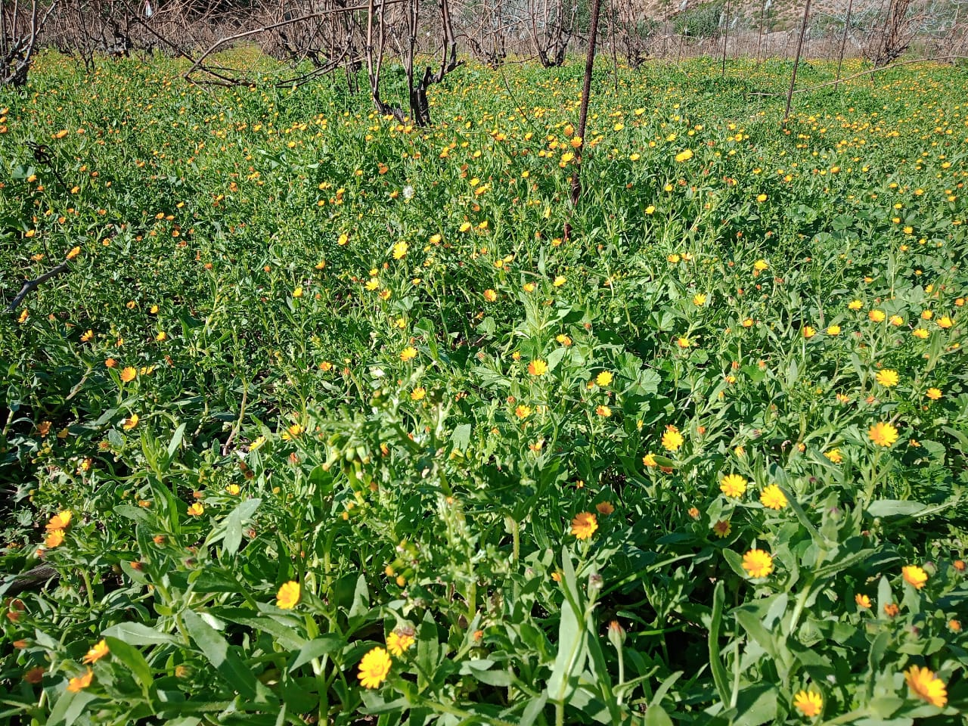
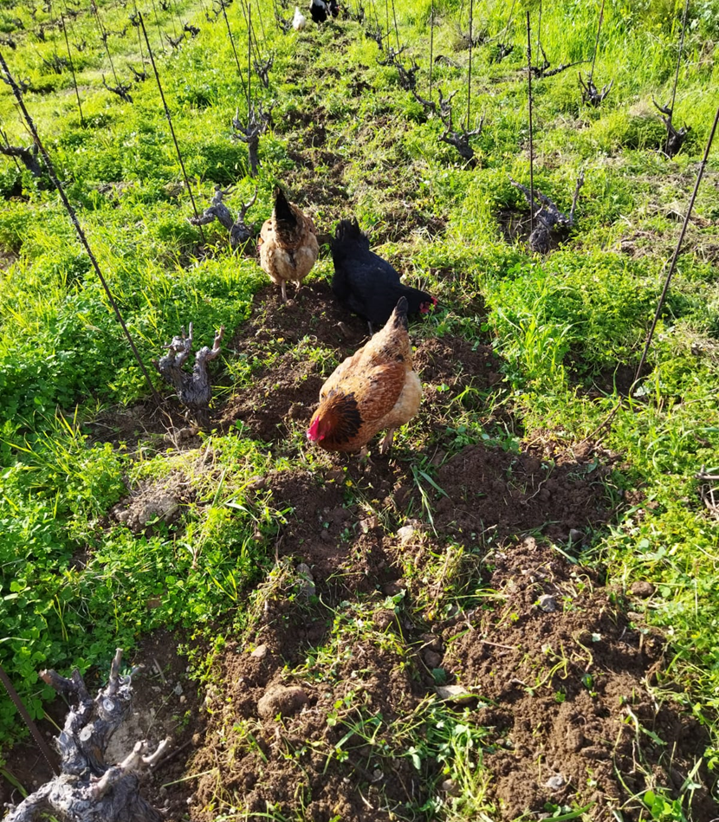
GESTION DU SOL
Enherbement
Travail du sol légèr
Paillage
Animaux
Compost
Plantation des arbres

Slide 14
Paillage avec du bois coupée
Umiditè du Sol
Control des herbes
Nutrition

Slide 15
Preparations Biodynamiques
tisanes d’ortie, oregan, valeriane
500/500P
Mejeur réponse aux stress biotiques et abiotiques -clima et pathogenes- (réponse gène-specifique)
(Soustre-Gacougnolle et al., 2018)

Slide 16
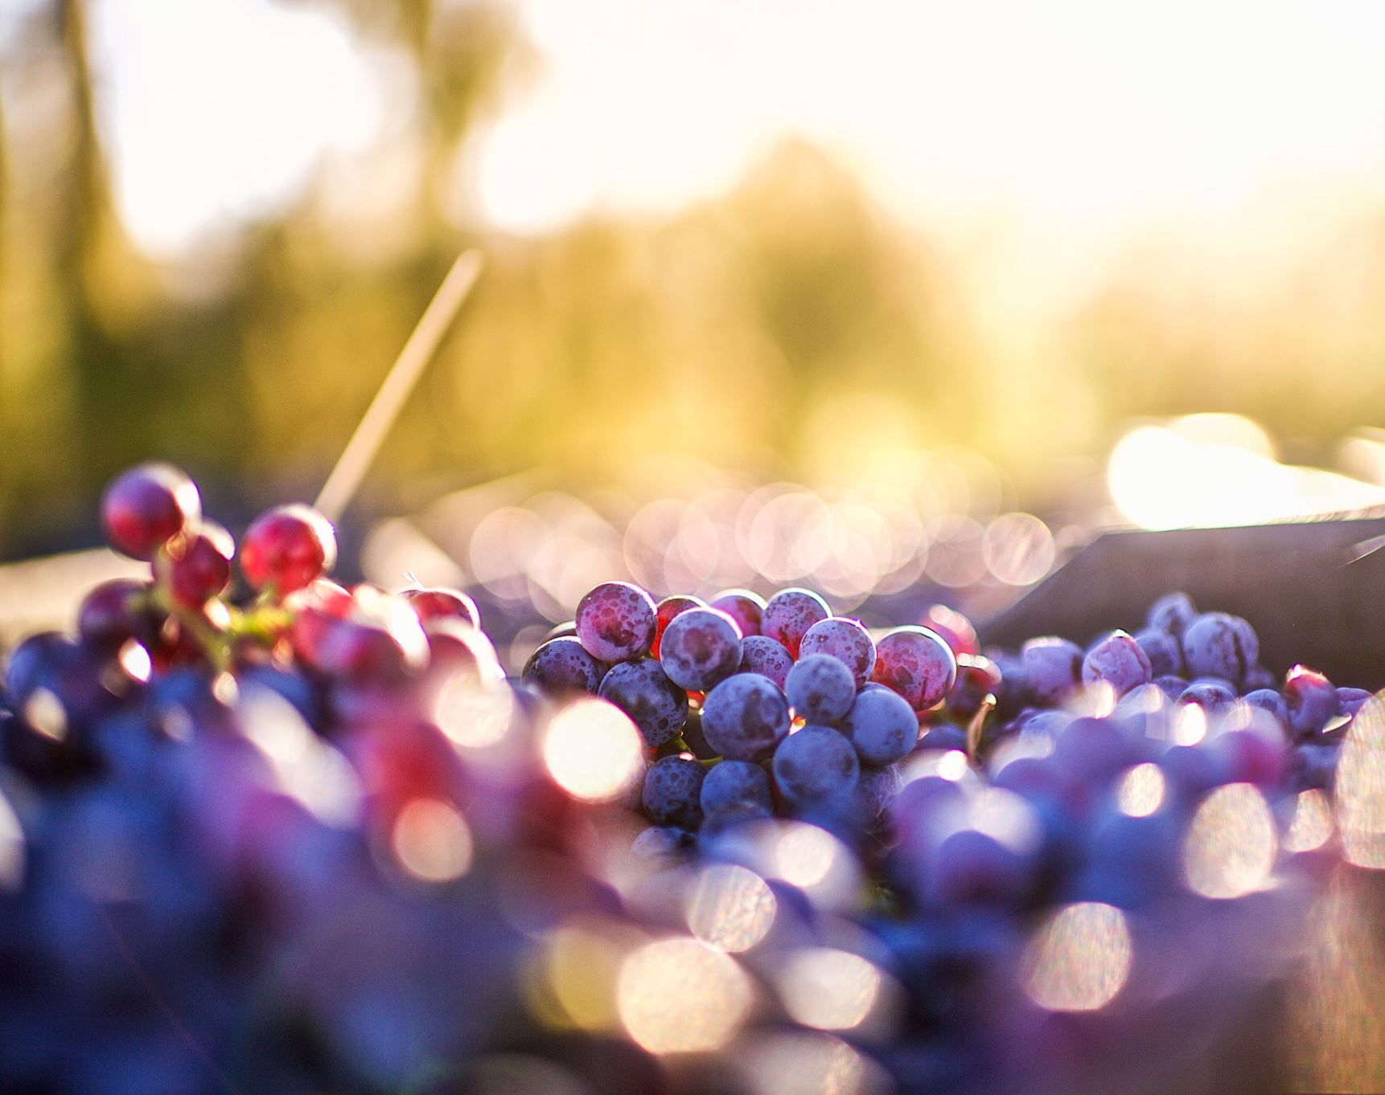
Dans la cave
Macérations courtes
Maceration carbonique
Récolte précoce

Slide 17
Autres solutions à essaiyer
Arrosage de précision
Taille tardive
Pincage tardif (veraison)
Vendanges progressives
Kaolin

Slide 18
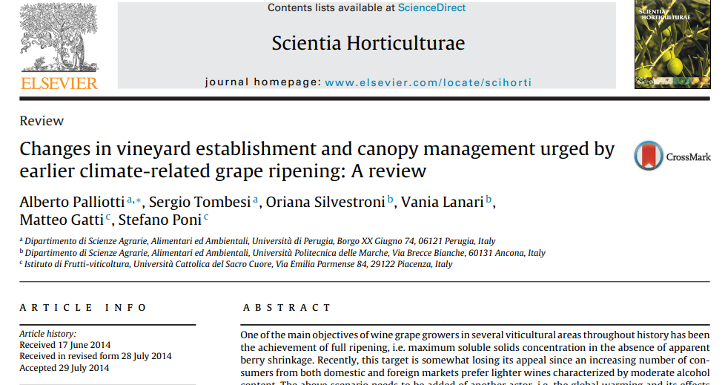

Slide 19
Changement Climatique et operations agronomique
Santillán, D., Garrote, L., Iglesias, A., & Sotes, V. (2019). Climate change risks and adaptation: new indicators for Mediterranean viticulture. Mitigation and Adaptation Strategies for Global Change. doi:10.1007/s11027-019-09899-w
T. K. Wolf, B. W. Zoecklein, M. K. Cook, C. K. Cottingham. Restricted accessShoot Topping and Ethephon Effects on White Riesling Grapes and Grapevines Am J Enol Vitic. January 1990 41:330-341; published ahead of print January 01, 1990
Palliotti, A., Tombesi, S., Silvestroni, O., Lanari, V., Gatti, M., & Poni, S. (2014). Changes in vineyard establishment and canopy management urged by earlier climate-related grape ripening: A review. Scientia Horticulturae, 178, 43–54. doi:10.1016/j.scienta.2014.07.039
10.1016/j.scienta.2014.07.039
Martinez de Toda, Fernando & Sancha, J.C. & Balda, Pedro. (2013).
Reducing the Sugar and pH of the Grape (Vitis vinifera L. cvs. 'Grenache' and 'Tempranillo’)
Through a Single Shoot Trimming.
South African Journal for Enology and Viticulture. 34. 246-251. 10.21548/34-2-1101.

Slide 20
Ignacio Buesa, José M. Mirás-Avalos, José M. De Paz, Fernando Visconti, Felipe Sanz, Antonio Yeves, Diego Guerra, Diego S. Intrigliolo. Soil management in semi-arid vineyards: Combined effects of organic mulching and no-tillage under different water regimes. European Journal of Agronomy,Volume 123,2021,126198,ISSN 1161-0301,https://doi.org/10.1016/j.eja.2020.126198.
Litskas, V.; Ledo, A.; Lawrence, P.; Chrysargyris, A.; Giannopoulos, G.; Heathcote, R.; Hastings, A.; Tzortzakis, N.; Stavrinides, M. Use of Winery and Animal Waste as Fertilizers to Achieve Climate Neutrality in Non-Irrigated Viticulture. Agronomy 2022, 12, 2375. https://doi.org/10.3390/agronomy12102375
A. Martínez-Moreno, F. Sanz, A. Yeves, R. Gil-Muñoz, V. Martínez, D.S. Intrigliolo, I. Buesa,
Forcing bud growth by double-pruning as a technique to improve grape composition of Vitis vinifera L. cv. Tempranillo in a semi-arid Mediterranean climate,
Scientia Horticulturae,Volume 256, 2019, 108614, ISSN 0304-4238, https://doi.org/10.1016/j.scienta.2019.108614.
Medrano, H., Tomás, M., Martorell, S. et al. Improving water use efficiency of vineyards in semi-arid regions. A review.
Agron. Sustain. Dev. 35, 499–517 (2015). https://doi.org/10.1007/s13593-014-0280-z

Slide 21
Biodiversity and biodynamic
Effects of different management regimes on microbial biodiversity in vineyard soils Maximilian Hendgen, Björn Hoppe, Johanna Döring, Matthias Friedel, Randolf Kauer, Matthias Frisch, Andreas Dahl, Harald KellnerScientific reports 8 (1), 1-13, 2018 Responses to climatic and pathogen threats differ in biodynamic and conventional vines Isabelle Soustre-Gacougnolle, Marc Lollier, Carine Schmitt, Mireille Perrin, Estelle Buvens, Jean-François Lallemand, Mélanie Mermet, Mélanie Henaux, Christelle Thibault-Carpentier, Doulaye Dembelé, Damien Steyer, Céline Clayeux, Anne Moneyron, Jean E MassonScientific reports 8 (1), 1-14, 2018 Vineyard management system affects soil microbiological properties Sofia Di Giacinto, Matthias Friedel, Christian Poll, Johanna Döring, Robert Kunz, Randolf Kauer OENO One 54 (1), 131-143, 2020
Exploring the potential of vineyards for biodiversity conservation and delivery of biodiversity-mediated ecosystem services: A global-scale systematic review Anna Paiola, Giacomo Assandri, Mattia Brambilla, Michela Zottini, Paolo Pedrini, Juri Nascimbene Science of the total environment 706, 135839, 2020 Manipulating vineyard biodiversity for improved insect pest management: case studies from northern California Miguel A Altieri, Luigi Ponti, Clara I Nicholls The International Journal of Biodiversity Science and Management 1 (4), 191-203, 2005

Slide 25
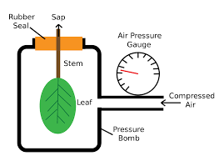
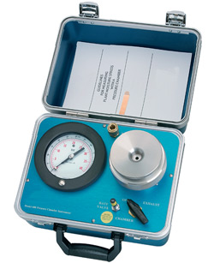
Sholander pressure bomb

Slide 26
